Slide 1
Blobs in Azure
Blobs Overview

Slide 2
Azure in a Day Training
Azure Blobs
Module 1: Azure Blobs Overview
Module 2: Blob Accounts
  DEMO: Setting up a Blob Account
  DEMO: Mapping a custom URI to Blob Account
Module 3: Blob Containers
  DEMO: Blob Containers
Module 4: Managing Blobs
  DEMO: Blob REST API
  DEMO: Uploading Block Blobs
Module 5: Securing Blobs
  DEMO: Setting Container Permissions
  DEMO Shared Access Signatures

Slide 3
Agenda
Overview
Azure Blob Model
  Account
  Container
  BLOB
Security
Additional Concepts

Slide 4
Overview of Windows Azure BLOBs
What are BLOBS
Shared Storage Requirements
How Azure BLOBs Stack Up
Introduction to the Azure BLOB APIs
Introduction to the Azure BLOB Security Model

Slide 5
What are BLOBs
Collection of binary data stored as a single object or entity
  Media Files
  Images
  VHD
  …
Notes:
According to wikipedia (http://en.wikipedia.org/wiki/Binary_large_object)
Jim Starkey - amorphous chunks of data invented by Jim Starkey at DEC, who describes them as "the thing that ate Cincinnati, Cleveland, or whatever"

Slide 6
The Challenge
Do you have enough space?
Is the solution elastic?
Is it load balanced (available)?
Is your data safe in the face of a disk crash (durable)?
What are the costs?
  Up front costs?
  Management costs?
Are your results consistent?
Is it performant (enough)?

Slide 7
Requirements For Shared Storage
Scalable
Available
Durable
Maintainable
Affordable
Reproducible (Consistent)

Slide 8
Scalability and Availability
Leverages Web Role infrastructure
Thousands of disk arrays
Efficient Failover
Automatic load balancing of blobs
Hot (frequently accessed) blobs served from multiple servers
Hot blobs cached multiple times
Notes:
Azure storage leverages ‘Web Role” infrastructure
Just like there are hundreds of thousands of servers in datacenters available to scale out for web roles, there are also thousands and thousands of disk arrays for storage
storage is truly utility computing –
think of it like electricity
Efficient Failover –
if there is a failure, your data will be served from a healthy replica
The problemed replica will be re-created elsewhere
hot blobs will be served from many servers to scale out and meet the traffic needs of your application

Slide 9
Durability
Data replicated at least 3 times
Data is spread out across fault and upgrade domains
Can choose to geo-replicate data
  Between 2 locations
  In same geo-region
  Asynchronous replication
Notes:
Fault domain
You can think of a fault domain as a physical unit of failure
There is no clear documentation on MS website, but it is probably best thought of as a rack
It is also not documented (or at least I couldn’t find it) what the default number of fault domains are, but it is between 3 and 5
Having your data stored across fault domains means that no single point of failure can cause you to lose your data
Upgrade Domain
Logical unit of upgrade

Slide 10
Maintainable and Affordable
Maintainable
  Let Microsoft handle the maintenance
  You concentrate on solving business problems
Affordable
  No upfront costs
  Utility computing
    Pay only for what you use (like electricity)
    Scale up or down on demand

Slide 11
Azure Blob Storage
Scalable – Sales to thousands of servers
Available – Load balanced; Hot blobs cached
Durable – Blobs replicated to at least 3 servers across fault domains
Maintainable – Let Microsoft handle it
Affordable – Utility computing; Pay for what you use; No upfront costs
Reproducible – Consistency guaranteed

Slide 12
Introducing the Azure BLOB APIs
REST API - Complete API
Client APIs – Wrappers around REST API
  Azure .NET SDK (StorageClient)
  Windows Azure SDK for Java
  Windows Azure SDK For PHP Developers
Client APIs hide complexity of
  Signing Requests
  Making HTTP Requests / handling responses
  Serialization / Deserialization
  …

Slide 13
Introducing the Azure BLOB Security Model
Private Access
Container Access Controls (ACLs)
Shared Access Signatures
  BLOB
  Container

Slide 14
Agenda
Overview
Azure Blob Model
  Account
  Container
  BLOB
Security
Additional Concepts

Slide 15
Blob Data Model
Account
  Highest level. All containers are scoped by storage account
  Unit of billing
Container
  An account can contain one or more containers
  1 level - containers cannot contain other containers
  Contain 0 or more blobs
  Access policies set at this level
Blob

Slide 16
Block Blob Data Model
Account
Container
Container
Blob
Blob
Blob
Blob

Slide 17
Account
The account is about ownership
Shared keys are assigned to account
Set location; Affinity Group
Enable CDN – more about this later
All containers belong to an account
URI to your account:
http://<account>.blob.core.windows.net
You can associate a “friendly” URI to your account

Slide 18
Containers
Microsoft Durable, Reliable BLOB Organizational Units 2009 R2
Contain Blobs
Single-level
Think of as a “Folder”
Scoped by account
Access Permissions – more later
    Private
    Public
      Full public read access
      Public read access for blobs only
URI to container :
http://<account>.blob.core.windows.net/<container>

Slide 19
Root Containers
Default container for your account
A BLOB can be addressed in a root container without referencing the root container name
The root container must be created (there is no root container by default)
Create by adding a container named $root
http://deveducate.blob.core.windows.net/$root/EF4.png
http://deveducate.blob.core.windows.net/EF4.png

Slide 20
Common Container Operations
ListContainers
Create
CreateIfNotExist
Delete
SetMetadata

Slide 21
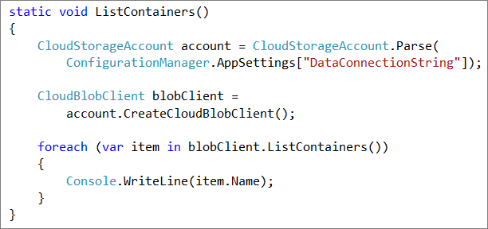
Listing Containers
Get reference to CloudStorageAccount
Get a CloudBlobClient
Call ListContainers()

Slide 22
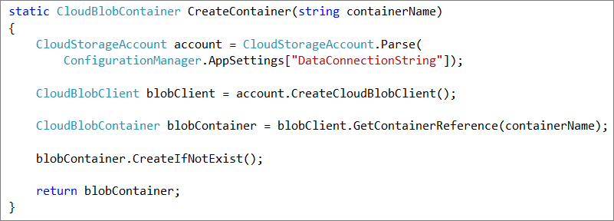
Creating a Container
Get reference to CloudStorageAccount
Get a CloudBlobClient
Get a reference to a container
Call Create() or CreateIfNotExist()

Slide 23
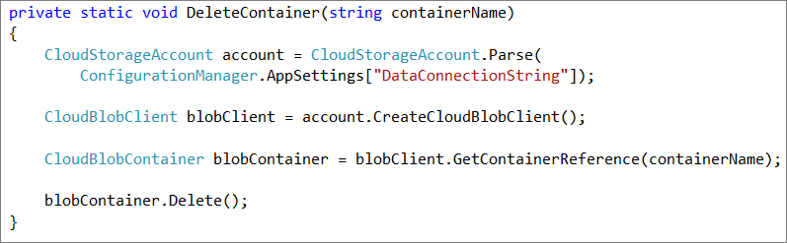
Deleting a Container
Get reference to CloudStorageAccount
Get a CloudBlobClient
Get a reference to a container
Call Delete()

Slide 24
DEMO
BLOB Containers

Slide 25
Agenda
Overview
Azure Blob Model
  Account
  Container
  BLOB
Security
Additional Concepts

Slide 26
Blob Data Model
deveducate (Storage Account)
images (container)
videos (container)
Logo.png (blob)
EF4.wmv (blob)
Home.png (blob)
MVC2.wmv (blob)
Contact.png (blob)
Azure.wmv (blob)
Template:
http://<account>.blob.core.windows.net/<container>/<blobname>
Example:
http://deveducate.blob.core.windows.net/images/Logo.png
http://deveducate.blob.core.windows.net/videos/EF4.wmv

Slide 27
2 Types of Blobs
Block blobs
  Original kind of blob
  Optimized for streaming (uploading a file to be downloaded in it’s entirety)
  Max size 200 GB
Page blobs
  Introduced with 9/19/09 release
  Provide the ability to write to a range of bytes in a blob
  Optimized for multiple random read/writes (mounting a drive)
  Max size 1 TB
  You have to align to the 512 byte boundry (multiple of 512)
Notes:
Once the blob has been created, its type cannot be changed
With page blobs - All pages must align 512-byte page boundaries

Slide 28
Adding Block Blobs
Blobs <= 64 MB can be added in single PUT
Blobs > 64 MB must be added via Blocks
  Break entire file down into blocks < 4MB
  PUT individual blocks with Block ID, storing the ID
  After all blocks are successfully uploaded, PUT blocklist containing all block IDs (in correct order)

Slide 29
Advantages of uploading via blocks
Not all or nothing
  Able to retry failed blocks
  a.k.a. - Continuation
Uploading in Parallel
Upload blocks in any order – only list of blocks in blocklist must be in order

Slide 30
Put Blob vs. PutBlock/PutBlockList
20 MB
Error
20 MB
5 MB
5 MB
5 MB
10 MB
15 MB
Start Again
PutBlock 006
PutBlock 005
PutBlock 003
PutBlock 002
PutBlock 001
PutBlockList 001, 002, 003, 004, 005, 006
PUT Block 005
Break it down into
Blocks <= 4MB
PutBlock 004
Error
Retry
ID: 001 (4 MB)
20 MB
ID: 001 (4 MB)
ID: 002 ( 4 MB)
ID: 002 ( 4 MB)
ID: 003 ( 3 MB)
ID: 003 ( 3 MB)
ID: 004 ( 3 MB)
ID: 004 ( 3 MB)
ID: 005 ( 2 MB)
ID: 005 ( 2 MB)
ID: 005 ( 2 MB)
ID: 006 ( 4 MB)
ID: 006 ( 4 MB)
Error

Slide 31
Block Blob Data Model
Account
Container
Container
Blob
Blob
Blob
Blob
Block
Block
Block
Block
Block
Block
Block
Block

Slide 32
BLOB REST API
HTTP Verb - provides intent
  GET – Fetch
  PUT – Insert or Overwrite
  DELETE
URI – identifies the resource you want to act upon
  http://<account>.blob.core.windows.net/<container>/<blobName>
  Additional QueryString Parameters
Request Headers – provide additional information about the request
Notes:
Additional QueryString parameters
blockid – When putting a block in a block blob
Snapshot
To view the VERBs, URI structures, QueryString parameters and Request Header, click here: http://msdn.microsoft.com/en-us/library/dd135733.aspx and click on each of the operations.

Slide 33
Sample PUT Blob
HTTP Method
PUT
URI
http://deveducate.blob.core.windows.net/sample/EF4.png
Request Headers
x-ms-blob-type: BlockBlob
x-ms-version: 2009-09-19
Host: deveducate.blob.core.windows.net
x-ms-date: Wed, 08 Dec 2010 11:26:23 GMT
Authorization: SharedKey deveducate:FyqaCOTaqYWSy7gIU7nafaztaNWPnAZWyUjgo24o/C8=
Content-Length: 17650

Slide 34
DEMO
BLOB REST API

Slide 35
Storage Client API
.NET Wrapper for REST API
Hides complexity of
  Signing Requests
  Issuing HTTP Requests
  Deserializing HTTP Responses
Benefits from:
  Intellisense
  Compilation
Some features may not be implemented

Slide 36
Common BLOB Operations
Upload / Download
  Sync and Async
  File, Stream, Byte array, Text
CopyFromBlob
CreateSnapshot
Delete (DeleteIfExists)
SetMetadata

Slide 37
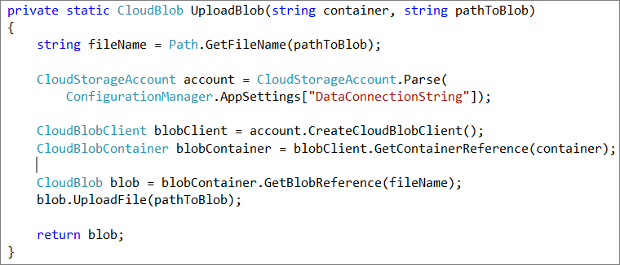
Uploading a BLOB
Get reference to CloudStorageAccount
Get a CloudBlobClient
Get a reference to a Container
Get a reference to a BLOB
Call UploadFile, UploadByteArray, UploadFromStream, UploadText

Slide 38
Uploading Block BLOBs
BLOBs <= 64MB can be uploaded with one PUT
BLOBs > 64 MB must be broken down into <= 4 MB chunks called Blocks
The StorageClient API
  V 1.2 Automatically breaks down BLOBs > 32 MB into 4 MB Chunks
  V 1.3
    Same behavior by default
    Can control

Slide 39
Some Useful CloudBlobClient Properties for Controlling Uploads
SingleBlobUploadThresholdInBytes – gets/sets the maximum size of a BLOB in Bytes that can be uploaded as a single BLOB (default 32 MB)
WriteBlockSizeInBytes – gets/sets the block size in Bytes
ParallelOperationThreadCount – gets/sets the number of blocks that can be uploaded in parallel (only if blob size > SingleBlobUpload…)
Notes:
SingleBlobUploadThresholdInBytes –
The maximum size of a blob, in bytes, that may be uploaded as a single blob, ranging from between 1 and 64 MB inclusive.
The default value is 33554432 bytes (32 MB)
*** This is the enabling property when working with the StorageClient API to take advantage of the Block BLOB functionality
If the size of the BLOB is larger than what you set this property at,
Parallel uploading comes into play
The size of the blocks that are uploaded are equal to what you set the WriteBlockSizeInBytes value

Slide 40
DEMO
Upload Blob

Slide 41
Agenda
Overview
Azure Blob Model
Development
Security
BLOB Scenarios
Accessing BLOBs

Slide 42
Permissions
Private – Shared Key Signing
SET ACL on Container
  Very Course
  Options
    Full public read access
    Public read access for blobs only
    Private
Shared Access Signatures
  More Fine Grained

Slide 43
Authorization Pseudocode
Create storage account; Receive Shared Key
Client: creates a signature string with certain parts of the request in a specific order
Client: Sign the signature string with the key
Client: Send signature string with the request
Server: Repeat steps 2-4 with server copy of shared key
Compare signatures

Slide 44
Neither Can:
List Containers
Create Container
Set Container Metadata
Get Container ACL
Set Container ACL
Delete Container
Put Blob
Set Blob Properties
Set Blob Metadata
Put Block
Get Block List (uncommitted blocks only or all blocks)
Put Block List
Delete Blob
Copy Blob
Snapshot Blob
Lease Blob
Put Page

Slide 45
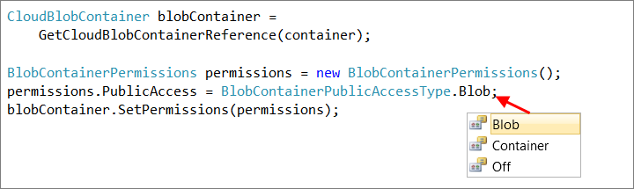
Setting Container Permissions

Slide 46
Shared Access Signatures
Allow you to apply a more granular access policy
Implemented as URL QueryString Parameters
Access Policy consists of:
  StartTime
  EndTime
  Permissions
Access Policy can be either:
  Included in the querystring parameters
  Applied to the container (container-level access policy)
Notes:
We’ll get to the container-level access policy in a moment

Slide 47

Shared Access Signature Example
URI to resource
Shared Access Policy
Signed Resource
Signed Identifier
Signature
Signed Start
Signed Expiry
Permissions
NOTES:
NOTES:
“sr=b” for blob
“sr=c” for container
NOTES:
Signed Identifier references a named container-level access policy
Start, End and Permissions can be defined there
NOTES:
Used to authenticate the request
NOTES:
Any or all of these can be applied to a container-level access policy
http://{account}.blob.core.windows.net/{container}/{blob}?
st=2010-11-25T12 00 00TZD&se=2010-11-25T12 30 00TZD&sp=r
&sr=b
&si=policyName
&sig=WBvuc8uiNHp3L5Sph2tu4XAPsoKNGY99Zltl0YN9qvc%3D

Slide 48
Container-Level Access Policy
Apply permissions to container
More secure and Best Practice
  Those permissions not included in URL
  Permissions can be revoked
  Duration can be > 1 hour

Slide 49
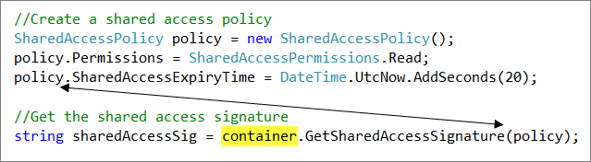
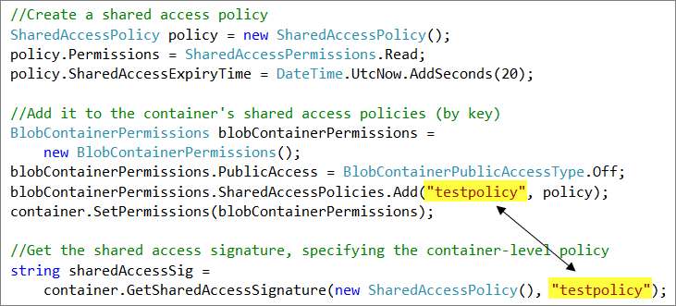
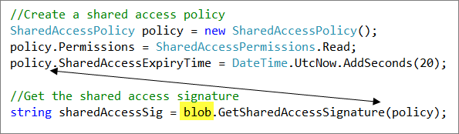
Example
Shared Access Signature on Blob
Shared Access Signature – with container-level access policy
Shared Access Signature on Container

Slide 50
Best Practices
Use container-level access policies
Limit the duration to as short as possible
Grant minimal permissions
Use Shared Access Signatures over HTTPS

Slide 51
DEMO
Shared Access Signatures

