Slide 1
Queues in Azure

Slide 2
Azure in a Day Training
Azure Queues
Module 1: Azure Queues Overview
Module 2: Enqueuing a Message
  DEMO: Creating Queues
  DEMO: Enqueuing a Message
Module 3: Dequeuing a Message
  DEMO: Dequeuing a Message
Module 4: 2-Phase Dequeue
  DEMO: Handling Delete exceptions
Module 5: Handling Poison Messages
  DEMO: Handling Poison Messages
Module 6: General Guidance
  DEMO: Exponential Backoff

Slide 3
Agenda
Azure Queues Overview
Common Queue Operations
  Creating a Queue
  Enqueuing a Message
  Dequeuing a Message
2 Phase Dequeue
Handling Poison Messages

Slide 4
What are Queues
FIFO (First-In-First-Out) structures
Items are enqueued on the bottom (rear) and dequeued from the top (front)
Check-out line metaphor
Purpose
  Loose coupling of systems
  Buffer

Slide 5
Loose Coupling of Systems
In Any Application
In Azure Hosted Applications
Worker Role
Consumer
Web Role
Producer
Worker Role
Consumer
Web Role
Producer
Azure Queue
Worker Role
Consumer
Web Role
Producer
Worker Role
Consumer

Slide 6
Loose Coupling of Systems
Consumer
Producer
Consumer
Producer
Azure Queue
Consumer
Producer
Consumer

Slide 7
The Process – Very Simplified
Consumers Get Messages from the top of the queue
  Get Message
  Operate on the message
  Delete the message
Producers Add Messages to the rear of the queue
Producer
Azure Queue
Consumer 1
Azure Queue
M1
M1
MSG
M2
M2
M3
Consumer 2
M4
MSG

Slide 8
Agenda
Azure Queues Overview
Common Queue Operations
  Creating a Queue
  Enqueuing a Message
  Dequeuing a Message
2 Phase Dequeue
Handling Poison Messages
Azure Queue General Guidance

Slide 9
Common Queue Operations
Queue Operations
  Create
  CreateIfNotExist
  Delete
Message Operations
  AddMessage – Enqueue
  GetMessage(s)
  DeleteMessage
2 Phase Dequeue

Slide 10
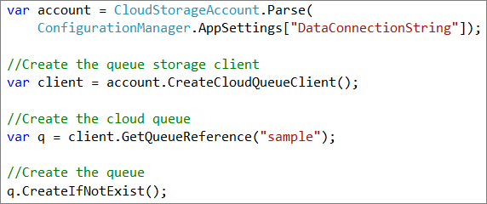
Creating a Queue
Get reference to CloudStorageAccount
Get a CloudQueueClient
Get a reference to a Queue
Call Create() or CreateIfNotExist()

Slide 11
Creating Queues - Notes
Create() & CreateIfNotExist() issue PUT to appropriate URI:
http://deveducatetraining.queue.core.windows.net/sample?timeout=90
Returns
  201 Created – if queue did not exist and was created
  204 No Content – if queue existed
*** Do not create queue more than once
  In most cases, you can think of this as a setup process like creating a database
  Not wrong to put in application initialization

Slide 12
DEMO
Creating Queues

Slide 13
Agenda
Azure Queues Overview
Common Queue Operations
  Creating a Queue
  Enqueuing a Message
  Dequeuing a Message
2 Phase Dequeue
Handling Poison Messages
Azure Queue General Guidance

Slide 14
Enqueuing a message
Get reference to CloudStorageAccount
Get a CloudQueueClient
Get a reference to a Queue
Create an instance of a CloudQueueMessage
Add the message to the queue

Slide 15
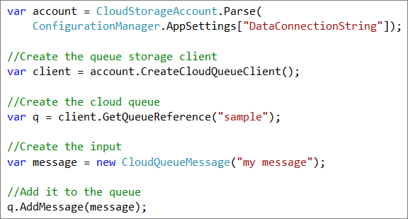
Enqueuing a message (code)

Slide 16
CloudQueueMessage
Message can be string or byte[] (overloaded constructor)
Messages
  Have xml wrapper
  Are base64 encoded
  Have 8 KB limit
PopReceipt
  Indicates that a message has been popped
  Used for deleting a message
DequeueCount
  Number of times a message has been dequeued
  Used to deal with poison messages
Notes:
Bring up the issue that you need to know what encoding you are using on the producer and consumer
The limit is less than 8KB if using the storage client because of the base64 encoding
There are also some convenience properties
AsString
AsBytes
PopReceipt used in conjunction with invisibility of message
There is a property NextVisibleTime

Slide 17
CloudQueue.AddMessage(…)
Pushes a message onto the rear of the queue
Time-to-live
  Length of time message will live on the queue if not deleted
  Default: 7 days
  Can be set with overload to AddMessage
Issues a POST
Returns 201 Created

Slide 18
DEMO
Enqueuing a message

Slide 19
End of module 2

Slide 20
Agenda
Azure Queues Overview
Common Queue Operations
  Creating a Queue
  Enqueuing a Message
  Dequeuing a Message
2 Phase Dequeue
Handling Poison Messages

Slide 21
Dequeuing a message
Get reference to CloudStorageAccount
Get a CloudQueueClient
Get a reference to a Queue
Call GetMessage(s)
Do some work
Call DeleteMessage, passing the message as a parameter (or the message id and pop receipt)

Slide 22
2 Phase Dequeue
Phase I
  Get Message(s)
  Set visibilityTimeout – time that message will be invisible to other queue message consumers
  You receive pop receipt when getting message
Phase II
  Delete Message
  Must pass valid pop receipt
  Exception thrown if bad pop receipt

Slide 23
The Process
A producer enqueues a message to the bottom (rear) of a specific queue
A consumer gets a lease on message(s) at top of a specific queue
  The consumer gets a copy of the message
  The consumer gets the message’s valid pop receipt
  The message on the queue is made invisible to other consumers for a period of time
The message becomes visible if it is not deleted within the VisibilityTimeout period
The consumer performs some operation on the message
  If successful, the consumer deletes the message, passing the pop receipt
    If the pop receipt is valid, the message is deleted from the queue
    Otherwise an error is thrown
  Why would it fail?
    The message was made visible and another consumer got a lease on it
    Race condition
Producer
Azure Queue
Consumer 1
Azure Queue
M5
M1
M1
M1
DeleteMessage(
)
M2
Rcpt1
M3
M4
Exception
M5
Notes:
VisibilityTimeout
Default: 30 seconds
Can be passed in

Slide 24
GetMessage and DeleteMessage
Getting a message
CloudQueueMessage GetMessage()
CloudQueueMessage GetMessage(TimeSpan visibilityTimeout)
Getting multiple messages
IEnumerable<CloudQueueMessage> GetMessages(int messageCount)
IEnumerable<CloudQueueMessage> GetMessages(int messageCount,
TimeSpan visibilityTimeout)
Deleting a message
void DeleteMessage(CloudQueueMessage message)
void DeleteMessage(string messageId, string popReceipt)

Slide 25
PopReceipt
Property of CloudQueueMessage
Set every time a message is popped from the queue (GetMessage or GetMessages)
Used to identify the last consumer to pop the message
A valid pop receipt is required to delete a message
An exception is thrown if an invalid pop receipt is passed

Slide 26
VisibilityTimeout
  If timeout expires prior to message being deleted, the message will be exposed to other consumers
VisibilityTimeout details
  Default: 30 seconds
  Minimum: 1 second
  Maximum: 2 hours
Notes
  Ensure you set the timeout to a span that is longer than it will take you to process the message

Slide 27
DEMO
Simple Dequeue

Slide 28
End of module 3

Slide 29
Agenda
Azure Queues Overview
Common Queue Operations
  Creating a Queue
  Enqueuing a Message
  Dequeuing a Message
2 Phase Dequeue
Handling Poison Messages
Azure Queue General Guidance

Slide 30
Illustrating the 2 Phase Dequeue
Race Condition
Step 1:
Consumer 1 calls GetMessage(5)
Azure assigns a PopReceipt “Rcpt1” to the message
Consumer 1 Receives the message and the PopReceipt
Message not visible to other consumers for VisibilityTimeout (5)
Step 2:
VisibilityTimeout (5 seconds here) expires
Message is now visible to other consumers
Step 3:
Consumer 2 calls GetMessage()
Azure assigns a PopReceipt “Rcpt2” to the message
Consumer 2 Receives the message and the PopReceipt
Message not visible to other consumers for VisibilityTimeout (30)
Step 4:
Consumer 1 calls DeleteMessage, passing PopReceipt “Rcpt1”
“Rcpt1” is no longer a valid PopReceipt
Azure throws an Exception (404)
Azure Queue
Azure Queue
Consumer 1
5
4
3
2
1
0
M1
M1
M1
M1
M1
M1
Rcpt1
Rcpt1
Rcpt2
Rcpt2
M2
M3
Consumer 2
M4
M5

Slide 31
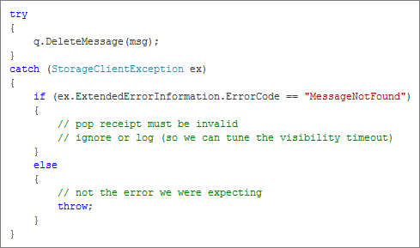
Handling Delete Exceptions
* Taken from Steve Marx’ blog post

Slide 32
Idempotency
Repeated actions have the same effect as one
i.e. The action can be run multiple times without issue
You should design your queue operations to be idempotent!
Plan for the reality that more than one consumer will receive your queue message

Slide 33
DEMO
Handling Delete Exceptions

Slide 34
End of module 4

Slide 35
Agenda
Azure Queues Overview
Common Queue Operations
  Creating a Queue
  Enqueuing a Message
  Dequeuing a Message
2 Phase Dequeue
Handling Poison Messages
Azure Queue General Guidance

Slide 36
Poison messages
Messages that cannot be processed and remain in the queue
Poison message process
  GetMessage(5) called (VisibilityTimeout of 5 secs)
  Some error occurs while processing the message
  After 5 seconds, the message is visible again
  Repeat

Slide 37
Handling Poison Messages
Messages have a DequeueCount
Always check the DequeueCount and if it exceeds your threshold, do something with the message and delete it
  Add it to a poison message queue
  (or do something clever)

Slide 38
DEMO
Handling Poison Messages

Slide 39
End of module 5

Slide 40
Agenda
Azure Queues Overview
Common Queue Operations
  Creating a Queue
  Enqueuing a Message
  Dequeuing a Message
2 Phase Dequeue
Handling Poison Messages
Azure Queue General Guidance

Slide 41
Azure Queue Guidance
Set appropriate visibilityTimeouts when getting messages
  VisibilityTimeout should be longer than it takes to process a message
  Use logging to tune visibilityTimeout
Message processing code should be idempotent
Always handle the StorageClientException where ExtendedErrorInformation.ErrorCode == "MessageNotFound”

Slide 42
Azure Queue Guidance - 2
Do not create queues more than once
  Can create queues in application setup
  Not bad to create a queue in application init
Always compare the DequeueCount to your threshold before processing a message
If messages are large, consider adding the message to BLOB storage and a pointer to the queue

Slide 43
Azure Queue Guidance - 3
Question “chatty” queue implementations
  The key is to understand the “nature” of your messages
  Consider bundling messages
Ensure message producer and consumer understand the message structure
Do not read from Queues in a “tight loop”
  Set appropriate wait times if no message is found
  Use exponential backoff when possible

Slide 44
DEMO
Exponential Backoff

Slide 45
Summary
Azure Queues Overview
Common Queue Operations
  Creating a Queue
  Enqueuing a Message
  Dequeuing a Message
2 Phase Dequeue
Handling Poison Messages
Azure Queue General Guidance

