Slide 1
Windows Azure
Windows Azure Overview

Slide 2
Azure in a Day Training:
Windows Azure
Module 1: Windows Azure Overview
Module 2: Development Environment / Portal
  DEMO: Signing up for Windows Azure
  DEMO: Creating a Hosted Service in the Azure Portal
  DEMO: Visual Studio Development Environment
Module 3: Service Management / Configuration
  DEMO: Configuration in Windows Azure
  DEMO: Mapping a custom URI to a hosted service
    www.azureinaday.com vs. azureinaday.cloudapp.net
  DEMO: Configuring SSL: https://www.azureinaday.com
Module 4: Diagnostics
  DEMO: Diagnostics in Windows Azure

Slide 3
Modules
Windows Azure Overview
Development Environment / Portal
Notes:
DEMOS
Overview
Development Environment
Hello World (Overview)
Show development environment (Development Environment)
Starting dev storage (Development Environment)
Certificates - auto deploy (Development Environment)
Service Management/Configuration
Show connection strings (Service Configuration)
SSL for site
Mapping URI
Diagnostics
Diagnostics (Diagnostics)

Slide 4
DEMO
Azure Application

Slide 5
Windows Azure Overview: Agenda
Windows Azure at 50,000 feet
Why should you care about Windows Azure
Windows Azure: The cloud OS

Slide 6

Windows Azure Platform
™
Platform Services
Windows Azure Platform
™
Windows Azure
SQL Azure
AppFabric

Slide 7
Windows Azure
™
Platform Services
Service Hosting Services
Shared Storage Services
Table Storage
BLOB Storage
Queues

Slide 8

Service Hosting Services
Storage Services
BLOB Storage
Web
Table Storage
Worker
Queues
Non-Cloud App

Slide 9
Cloud Service Offerings
Private
(On-Premise)
Infrastructure
(as a Service)
Platform
(as a Service)
Software
(as a Service)
On-Premise (none)
Infrastructure as a service
Platform as a service
Software as a service
Applications
Applications
What you want to manage
You manage
Data
Data
Runtimes
You manage
Runtimes
Security & Integration
Security & Integration
Databases
Databases
You manage
Servers
Servers
Virtualization
Virtualization
Server HW
Server HW
Storage
Storage
Networking
Networking
Notes:
With Infrastructure aaS
You get a box
Platform aaS
Runtime

Slide 10
Windows Azure Overview: Agenda
Windows Azure at 50,000 feet
Why should you care about Windows Azure
Windows Azure: The cloud OS

Slide 11
Why do you care?
The “ilities”
  Scalability
  Reliability
  Durability
  Availability
Development Environment
Utility Computing Model
No Administration

Slide 12
Scalability
“…the ability of a system, network, or process, to handle growing amounts of work in a graceful manner or its ability to be enlarged to accommodate that growth”
- Wikipedia.org
Notes:
Service Hosting
No need to try to predict demand
Spin up/down on demand
Storage
Tables
Terrabytes of data
Horizontal partitioning
Blobs

Slide 13
Scale Up/Down to meet demand
Start-ups
Seasonality
Time-of-day
Bursts
  Predictable
  Unpredictable

Slide 14
Reliability
“… the ability of a system or component to perform its required functions under stated conditions for a specified period of time”
- Wikipedia.org
Notes:
This is interesting
You might mistake this for meaning that an individual node is reliable
Like it or not, many, many applications are written with this assumption
Azure is quite different. The assumption is that a given node, rack, router, load balancer, etc. will go down.
What reliability means to Azure is that
From a service hosting perspective
If you follow certain guidelines, your application will be reliable given that these failures occur
Data perspective
There are really no guidelines.
Your data will be available
Written in 3 places when you persist it
Your data will be served off a different node

Slide 15
Durability
“…property which guarantees that transactions that have committed will survive permanently”
- Wikipedia.org
Notes:
Again, your data is written in 3 places.
If one node blows up, it exists in 2 other places. A third replica will shortly be created

Slide 16
Why do you care?
The “ilities”
  Scalability
  Reliability
  Durability
  Availability
Development Environment
Utility Computing Model

Slide 17
Windows Azure Overview: Agenda
Windows Azure at 50,000 feet
Why should you care about Windows Azure
Windows Azure: The cloud OS

Slide 18
What is Windows Azure
Think of it as an operating system for the cloud
Provides similar features as a traditional OS (at cloud scale)
Provides cloud features like
  DNS
  Load balancing
Abstracts away the details of hosting scalable services
Allows you to concentrate on the service itself
Notes:
Typical OS
Manages memory
Schedules tasks
Abstracts away hardware

Slide 19
Terms
Fabric : network of interconnected nodes
Fabric controller: Acts as the kernel for our cloud OS
  Monitors the health of services
  Allocates resources
  Handles scaling
  Deployment and upgrades
  Load balancing

Slide 20
Service Model
Defines the requirements for your service
Includes things like
  Size of your instance
  Update/upgrade domains
  Fault domains
  Endpoints (internal and input)
  Access to local resources
  Certificates
Described (partially) by .csdef file
Configuration provided in .cscfg
Notes:
Local resources = local storage

Slide 21
Fault / Update Domains
Fault domain
  A physical unit of failure
  Having data spread across fault domains protects you against a single point of failure
Upgrade domain
  A logical unit of upgrade
  The fabric will perform in-place upgrades to 1 fault domain at a time
Notes:
Fault domain
You can think of a fault domain as a physical unit of failure
There is no clear documentation on MS website, but it is probably best thought of as a rack
It is also not documented (or at least I couldn’t find it) what the default number of fault domains are, but it is between 3 and 5
Having your data stored across fault domains means that no single point of failure can cause you to lose your data
Upgrade Domain
Logical unit of upgrade

Slide 22
Compute (Role) Options
Web Role – Node running Windows Server 2008 (R2) and IIS7(.5)
Worker Role – Node running Windows Server 2008 (R2)
VM Role – Runs an image of a Windows Server 2008 R2 Virtual Machine
*** (to run in R2, specify osFamily="2" in the
ServiceConfiguration.cscfg.)
Notes:
VM Role
You create the Windows Server 2008 R2 VHD image
Upload it to Azure
This VHD can be loaded on demand into a VM Rule

Slide 23
Compute Instance Sizes
Compute Instance Size | CPU | Memory | Instance Storage | I/O Performance | Cost per hour
Extra Small | 1.0 GHz | 768 MB | 20 GB | Low | $0.05
Small | 1.6 GHz | 1.75 GB | 225 GB | Moderate | $0.12
Medium | 2 x 1.6 GHz | 3.5 GB | 490 GB | High | $0.24
Large | 4 x 1.6 GHz | 7 GB | 1,000 GB | High | $0.48
Extra Large | 8 x 1.6 GHz | 14 GB | 2,040 GB | High | $0.96
* at the time of recording

Slide 24
Modules
Windows Azure Overview
Development Environment / Portal
Notes:
DEMOS
Overview
Development Environment
Hello World (Overview)
Show development environment (Development Environment)
Starting dev storage (Development Environment)
Certificates - auto deploy (Development Environment)
Service Management/Configuration
Show connection strings (Service Configuration)
SSL for site
Mapping URI
Diagnostics
Diagnostics (Diagnostics)

Slide 25
Dev Environment / Portal Agenda
Signing up for Azure
Creating a hosted service
Development Environment

Slide 26
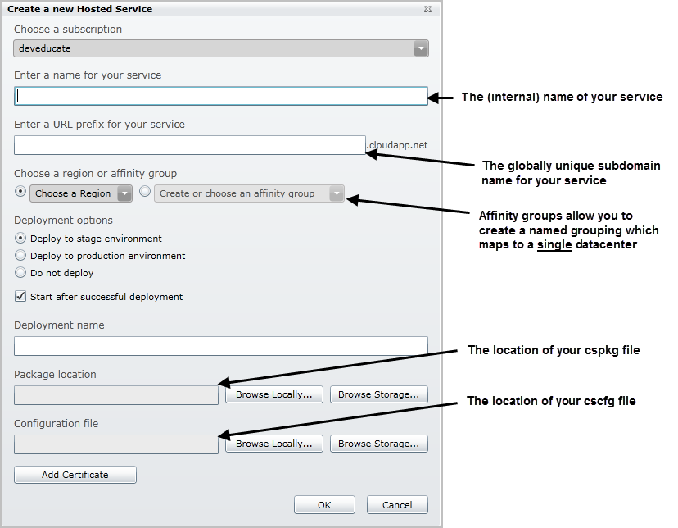
Creating a hosted service

Slide 27
Region or Affinity Group
You can choose to deploy by
  Region
  Affinity Group
Affinity Groups
  Named groups that map to a single datacenter
  Allow you to co-locate services / storage / SQL Azure

Slide 28
Developer SDK and Visual Studio Tools
Visual Studio Template
Development Fabric
Development Storage
Visual Studio Deployment Tools
StorageClient

Slide 29
Windows Azure Project Template
Creates Windows Azure Project
Allows you to add the following Role(s)
  Web Role
    ASP.NET web role – classic ASP.NET Web Application
    ASP.NET MVC2 web role
    WCF Service web role
    CGI web role – FastCGI Applications like PHP
  Worker Role
  Virtual Machine Role
Notes:
Windows Azure project. The Windows Azure Project has associations to the role projects in the solution. It also includes the service definition and service configuration files. The service definition file establishes the runtime parameters for a service, and the service configuration file sets them for a running instance of a service

Slide 30
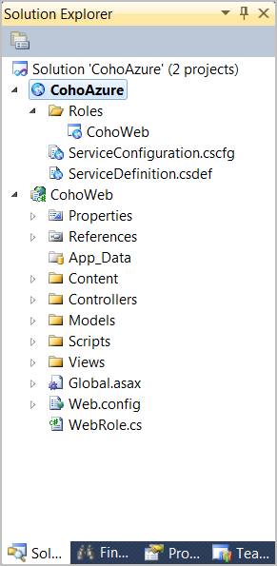
Windows Azure Project
Add a new Role Project
Associate to Role Project
Start Development Storage
Contains configuration
  *.csdef
  *.cscfg
Exposes Commands
  ‘Publish’
  ‘Browse to Portal’
More…

Slide 31
Development Fabric Compute Emulator
Local Simulation Environment for the Cloud
Azure equivalent to Cassini
Allows for debugging and monitoring
  Attach debugger
  View logging and diagnostic information as it is being written to the Windows Azure log
  Open the local store
Auto-assigns ports

Slide 32
Development Storage Storage Emulator
Local simulation of Blob, Queue and Table Cloud Storage
Uses SQL Server (Express by default) under the hood
Account Information for Development Storage
  Account name: devstoreaccount1
  Account key: Eby8vdM02xNOcqFlqUwJPLlmEtlCDXJ1OUzFT50uSRZ6IFsuFq2UVErCz4I6tq/K1SZFPTOtr/KBHBeksoGMGw==
  UseDevelopmentStorage=true
Service URIs
  Blob: http://127.0.0.1:10000
  Queue http://127.0.0.1:10001
  Table http://127.0.0.1:10002
Differences between Development Storage and Cloud
Notes:
http://msdn.microsoft.com/en-us/library/dd179339.aspx – Guidance on how to configure local storage to use a local instance of SQL Server

Slide 33
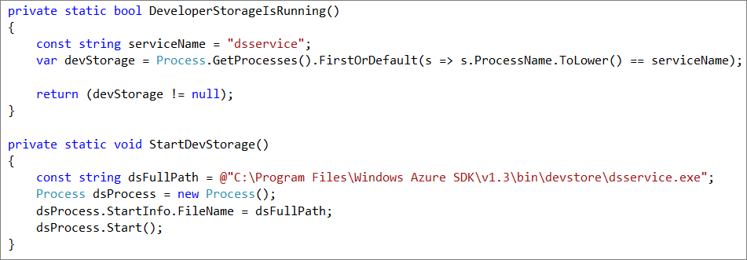
Manually Starting Development Storage
Start
C:\Program Files\Windows Azure SDK\v1.3\bin\devstore\dsservice.exe
Stop
C:\Program Files\Windows Azure SDK\v1.3\bin\devstore\dsservice.exe /shutdown

Slide 34
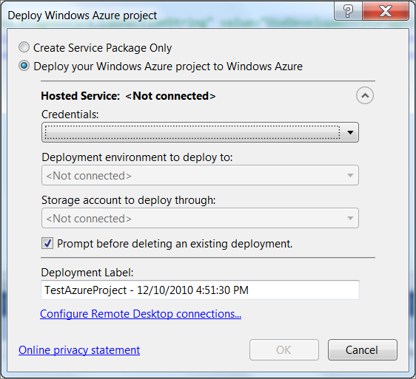
Deployment Tools
Allows you to deploy to the cloud directly from Visual Studio
Configure certificate
for authentication

Slide 35
End of windows Azure Overview

